Slide 1
Portable and Performant GPU/Heterogeneous Asynchronous Many-Task Runtime System
Ph.D Research Proposal

Slide 2
High-level goal
Demonstrating performant execution of a production quality many-task simulation on GPUs using tasks previously written with Kokkos constructs for CPUs and Xeon Phis.

Slide 3
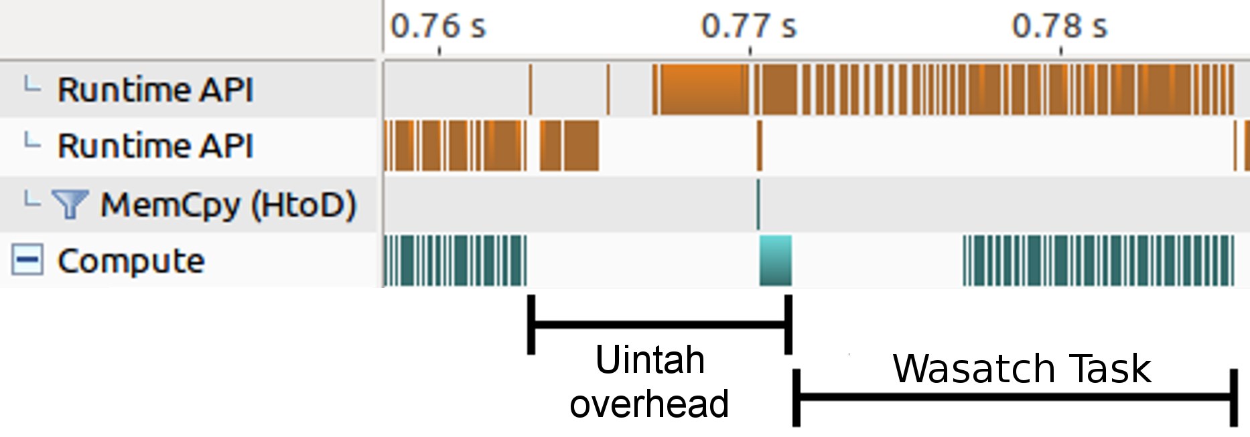
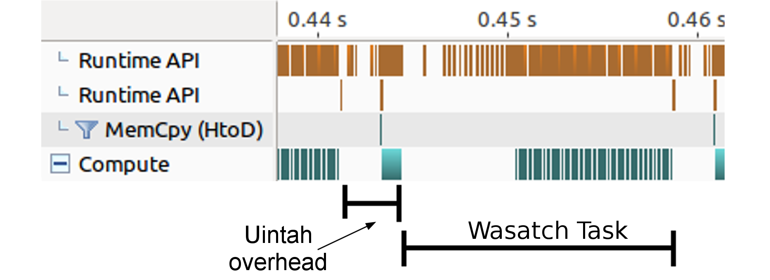
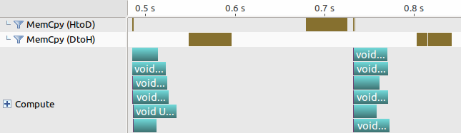
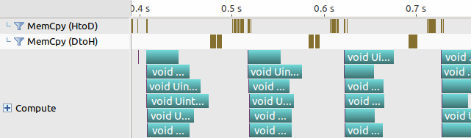
Performant
Low wall time overhead between time steps.
Lower memory usage due to data sharing.
Enables task developers to write performant code.
Can’t force performant code, and they can still write slow code!

Slide 4
Portable
Kokkos
Run Kokkos enabled tasks on GPUs, CPUs, and Xeon Phis.
Task API
Preserve application layer API with minimal GPU runtime interaction.
Data Warehouse API
Keep data warehouse logic and use uniform for host and GPU memory

Slide 5
Novelty of This Work
 | AMT runtime | Developer involvement with runtime | Automatic internodal data movement | Automatic halo gathering | Runtime data store | Automatic data sharing among tasks | GPU support | Portable code for CPU and GPU tasks
Uintah | Yes | Light | Yes – local memory/MPI | Host mem. (This work for GPU) | Host mem. (This work for GPU) | This work | Yes | This work
Charm++ | Yes | Medium | Invoked by user | No | No | No | With add-ons | Weak
Legion | Yes | Heavy | Yes – global memory | Yes | No | Yes | Yes | No
HPX | Yes | Medium | Yes – global memory | No | No | No | No | No
OpenACC | No | N/A | No | No | No | No | Yes | Yes
OpenCL | No | N/A | No | No | No | No | Yes | Yes
CUDA Unified Memory | No | N/A | No | No | No | Yes | Yes | N/A
Kokkos | No | N/A | No | No | No | No | Yes | Yes

Slide 6

Prior Uintah GPU runtime
Proof of concept
Halo gathers happened in host memory
Every GPU task required an allocate, and a host-to-device copy
After GPU task execution perform a device-to-host copy
Serial execution of GPU tasks

Slide 7
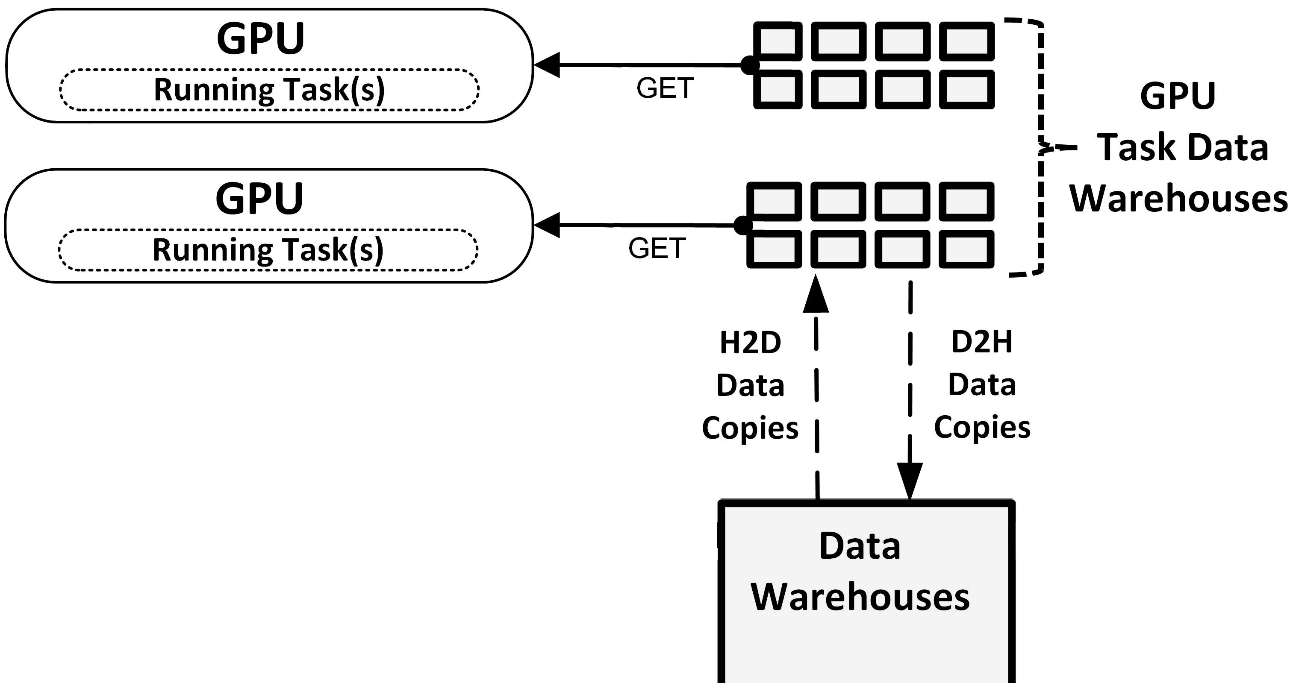
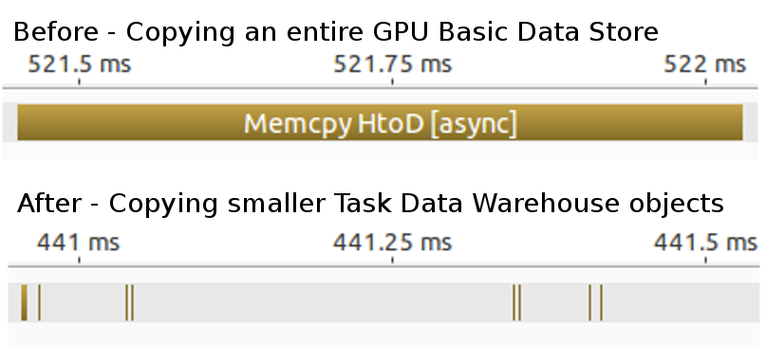
Task GPU Data Warehouse
Now each GPU task receives its own data warehouse
Difficult for asynchrony and concurrency to use one shared GPU data store
Tasks can only access simulation variables they indicated they would.

Slide 8
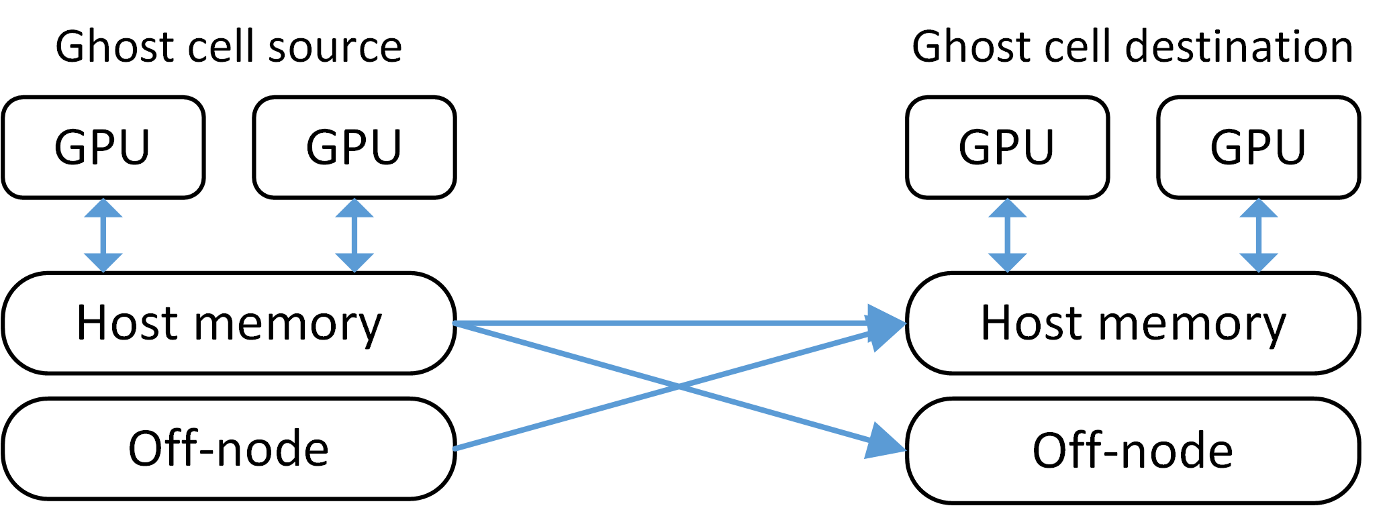
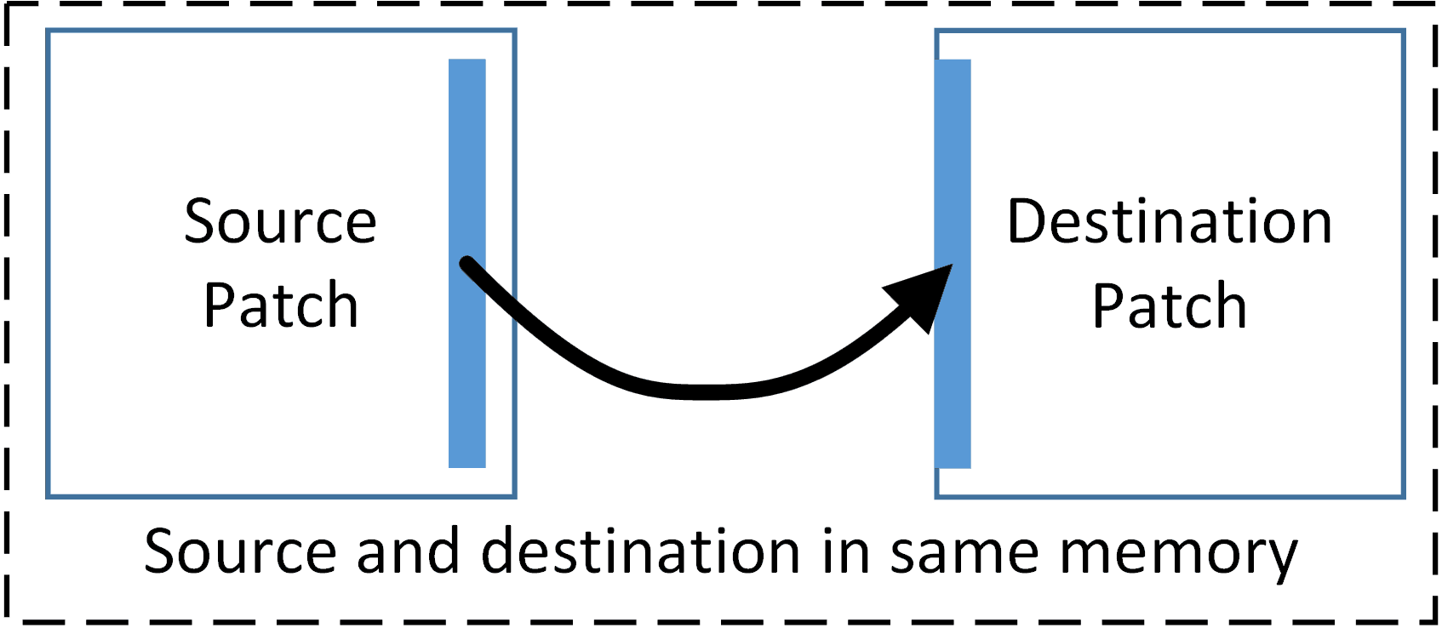
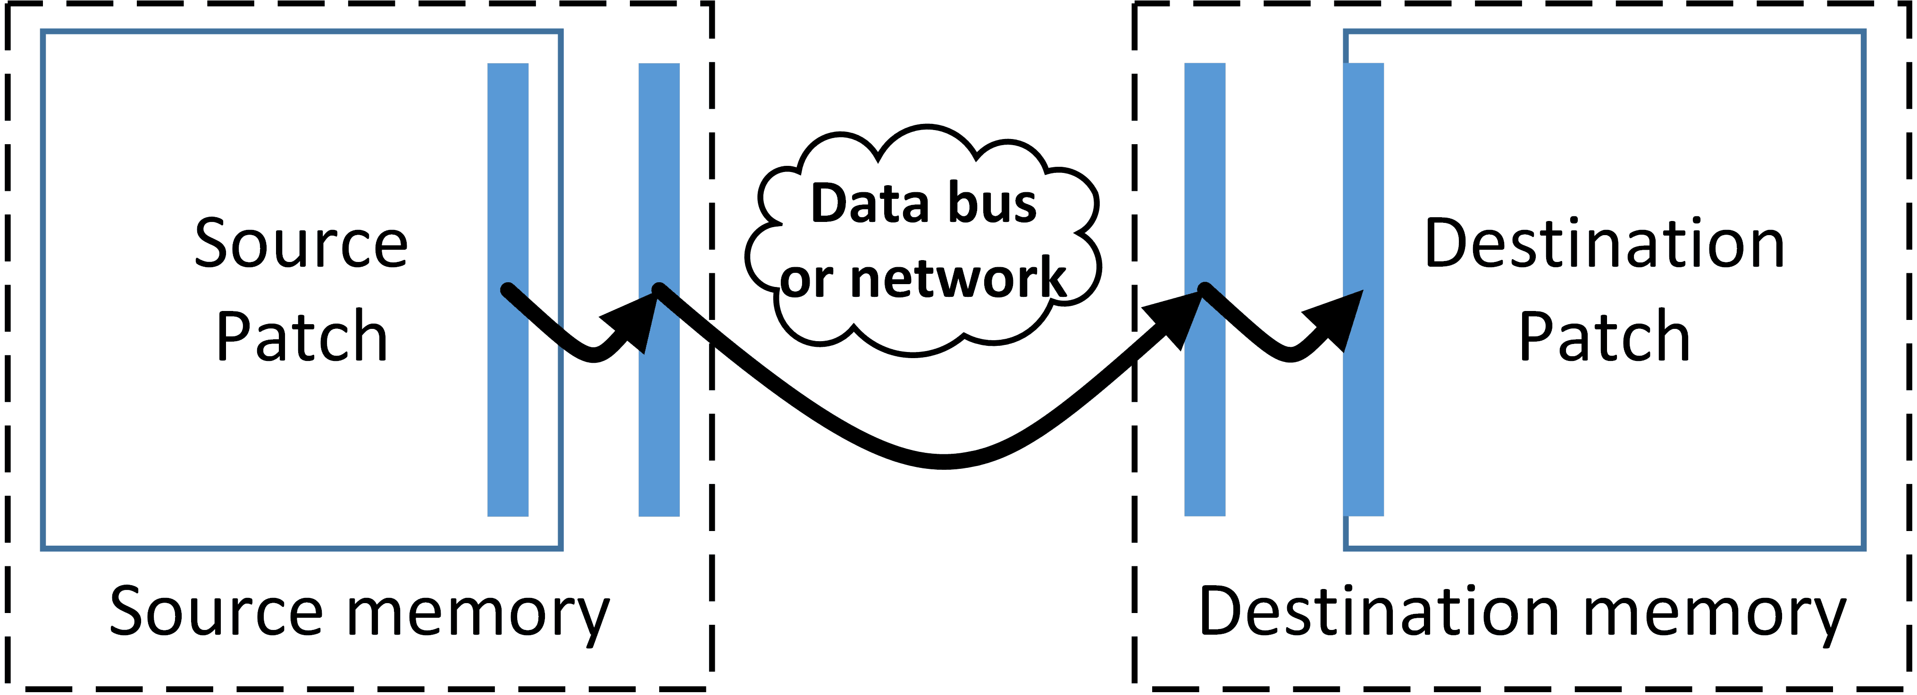
Halo Gathers in GPU memory
Before, all halo gathers happened in host memory
Copying changed so halos can copy within the same memory region
Halo buffers also sent into GPU memory if simulation variable resides there.

Slide 9
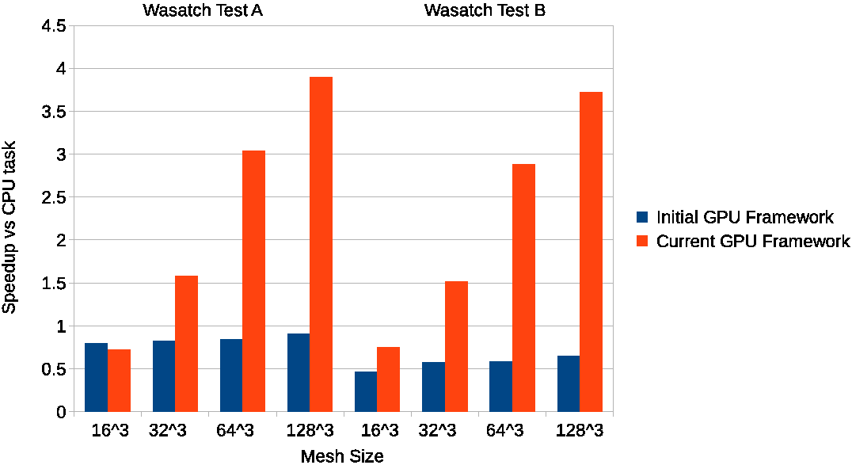
Tasks Dictate Data Persistence
Task scheduler now allocates and moves data into a memory space if it’s not already there.
This model works if Uintah ever switches to a dynamic task graph.

Slide 10
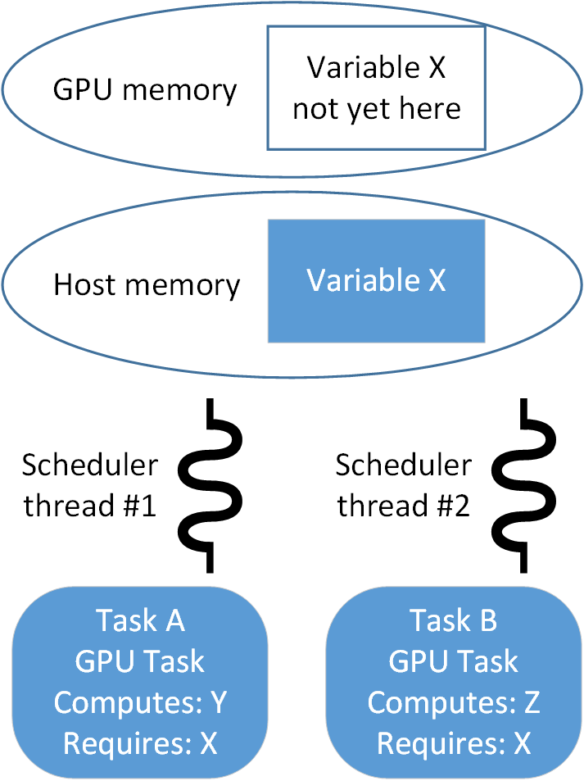
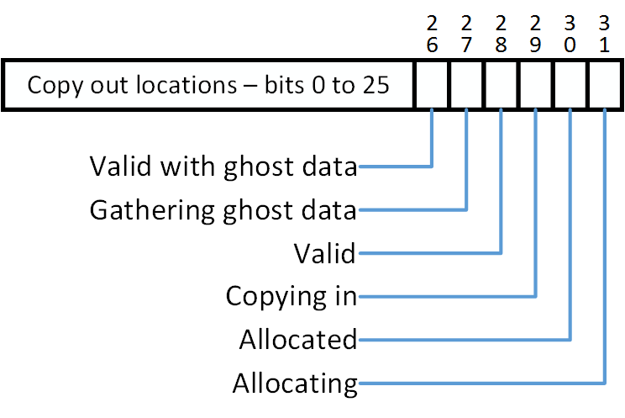
Data Sharing Among Tasks
Common use case: Two scheduler threads are assigned a different task to analyze. Each requires X in GPU memory, but it is not yet there.
Task scheduler threads now coordinate with one another (before they were fully independent).
Status bitset assigned for each simulation variable. Allows scheduler threads to coordinate.

